Slide 1
Python Server-Side Programming
Python Basics

Slide 2
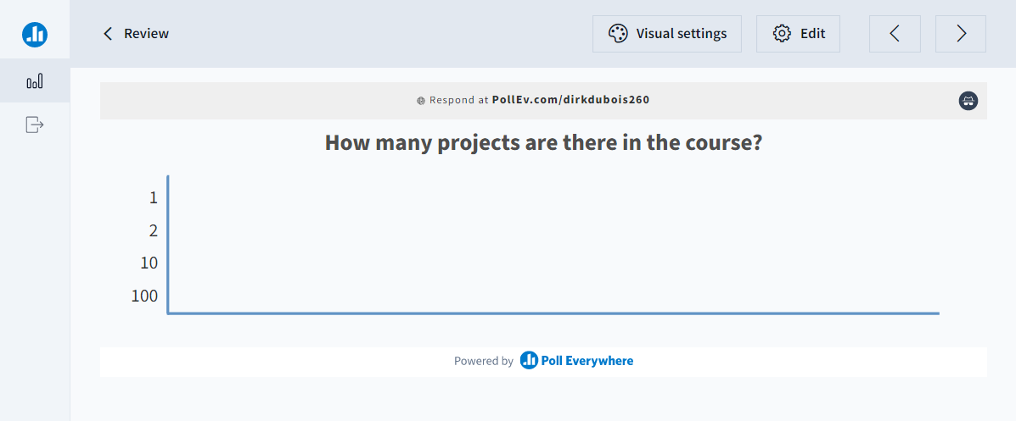
Let’s review

Slide 3
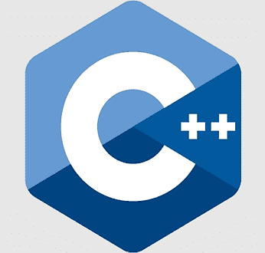


3 types of programming languages
Compiled (Native)
Compiled (Interpreted)
Interpreted

Slide 4
Python has been around a long time
C 1970
C++ 1983
Java 1995
Javascript 1995
C# 2000
Python 1991
Perl 1987
Python 3 2008

Slide 5


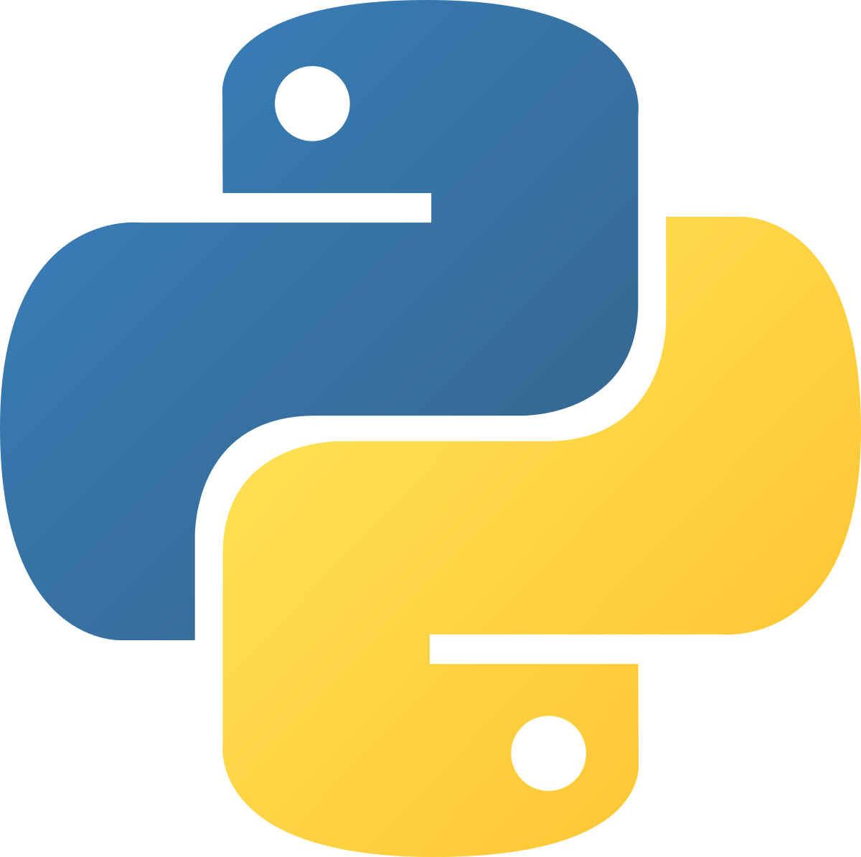
There are different python implementations
PyPy (JIT compiler)
IronPython (uses .Net Framework)
CPython (reference)

Slide 6
Python source files are interpreted
Python source file (.py)
Python Interpreter (e.g. python.exe)
All contained inside the python interpreter written in C
bytecode
Python VM
OS

Slide 7
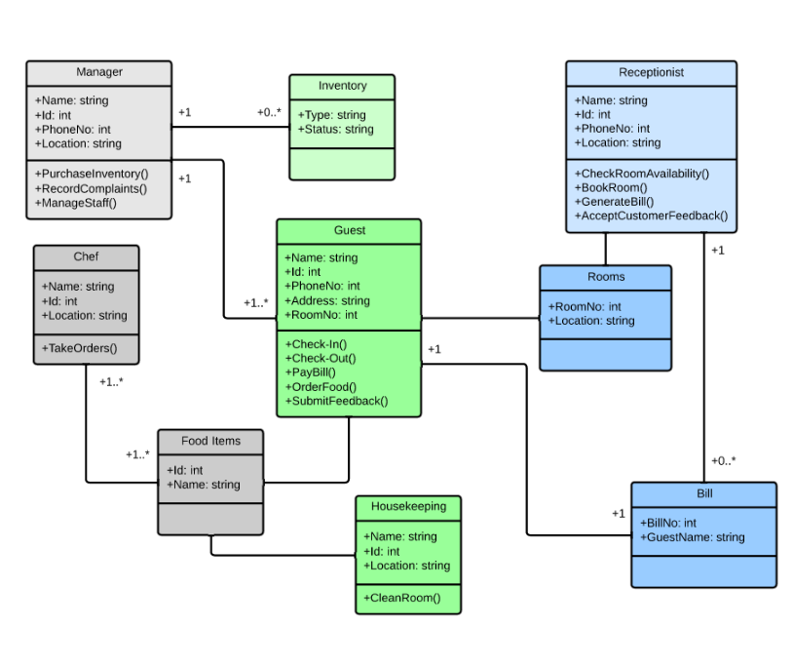


Python has some features we have seen before
Object Oriented
Garbage Collection
Dynamically Typed

Slide 8
Different languages have different features
Strongly Typed
C#
Ruby
Java
Python
Dynamically Typed
Statically Typed
Perl
C
JS
C++
Loosely Typed

Slide 9
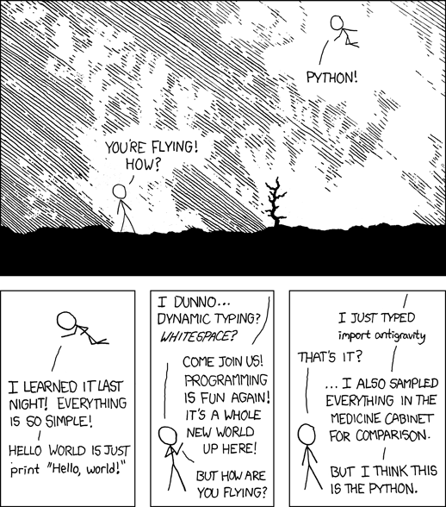
Python is considered easy to use
Dynamic typing makes prototyping fast
White space delimited means light syntax
Powerful as scripting language but can be used as a full OO language
Many standard libraries and even more to download

Slide 10
Writing basic python
We place our python code in a .py file
Variables don’t need a type thanks to the dynamic typing
Everything is white space delimited
Lots of built-in types
first_name = "Dirk"
last_name = "Dubois"
print("Hello World "
+ first_name
+ " " + last_name)

Slide 11
Python has built-in types
Text Type | str
Numeric Types | int, float, complex
Sequences Types | list, tuple, range
Mapping Type | dict
Set Types | set, frozenset
Boolean Type | bool
We have built-in functions to help us convert from one to type to another
E.g. str(1) converts the integer into “1”
E.g. float(“3.14”) converts the str into the float 3.14

Slide 12
Lists are dynamic structures in python
We use the [] to denote a list
Can contain data of the same type
Grow and shrink as you add and remove elements
names = ["Alice", "Bob", "Charlie"]
print(names[0])
names.append("Dirk")
names.remove("Alice")

Slide 13
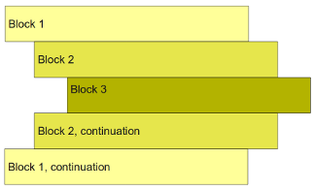
Indentation determines the code blocks
foo = 1
bar = 2
if foo == 1:
if bar == 2:
print(foo + bar)
else:
print(bar)
else:
print(foo)

Slide 14
Control statements and loops are very similar to other languages
If/else/elif provides statement control
Note, True and False have capitals in their keywords in Python
While/for loops provide looping
For loops have the in operator for iterating over collections
names = ["Alice", "Bob", "Charlie"]
for name in names:
print(name)

Slide 15
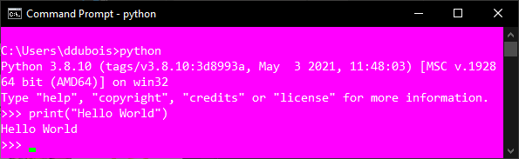
Python has an interactive REPL console
Read
Evaluate
Print
Since python is an interpreted language you can write code live in the console

Slide 16
Demo of Python Console
Using REPL to do simple things

Slide 17
Defining functions is easy
We use the def keyword to define a function
It does not have to return anything
It can take parameters or not
Again, we use tabs to define the start and end of the function
def get_name(first_name, last_name):
full_name = first_name + " " + last_name
return full_name
full_name = get_name("Dirk", "Dubois")
print(full_name)

Slide 18
Exceptions help us handle runtime errors
Runtime errors cause “Tracebacks”
try/except blocks handle errors
raise throws a new exception
names = ["a", "b", "c"]
i = 0
try:
while i < 5:
i = i + 1
print(names[i])
except LookupError as e:
print(e)

Slide 19
Running python scripts
Call the python interpreter with the file you want to run
Interpreter reads file from top to bottom
Syntax errors are caught first
Run time errors are only caught if the line is run
import os
print("I'm here")
def myFunc():
print ("myFunc")
print("End here")
myFunc()

Slide 20
Python has a coding standard
first_name = "Dirk"
last_name = "Dubois"
class MyObject:
def __init__(self):
pass
import os
import time
import pathlib
Check out PEP 8 for more details
https://www.python.org/dev/peps/pep-0008/
snake_case for variables
PascalCase for classes
import statements on new lines

Slide 21
Many standard libraries
We use import to use libraries
os for creating files and manipulating directories
pathlib for creating os independent paths
argparse for reading cmd line args
logging for creating logs
csv for reading CSV files
See python library for more details https://docs.python.org/3/library/
import os
import csv
folder = "MyFolder"
file_name = "myFile.csv"
file_path = os.path.join(folder, file_name)
csv_file = open(file_path)
csv_reader = csv.reader(csv_file)

Slide 22
Coding Demo
Setting up Flask together

